Slide 1


PizzaZone
Presented By-
Abhishek shetty(229003)
Chinmay vyawahare(229113)
http://www.free-powerpoint-templates-design.com

Slide 2

Points to be discussed
Screenshots
Specification
Conclusion
Introduction
Motivation
Disadvantages
Future Enhancement
References
Advantages
S/W and H/W
Requirement
Objectives
UML Diagrams

Slide 3
Introduction
Portal is a web system that provides the function and features to authenticate and identify the users and provide then with easy, intuitive, personalized and user-customizable web-interface for facilitating access to information and services that are of primary relevance and interests to the users. Student Portal is nothing but a portal which thinks students as the main target users & provides so many useful services to students at a single place & through a single interface but in customized form.

Slide 4
Motivation
Now a days the system in the institute has the process of making the paper report in any department which is done manually which in turn increases the time requirement.
Due to pandemic, the institute faces multiple difficulties for communicating as well as sharing required resources to the students.
Students and faculties has to go through various procedure to communicate with the institute in order to change his profile or course related details.
Students and Faculties can not get all the requirements that are necessary for the completion of their course. Hence, they require a proper platform of communication.
Student’s Online Portal will reduce institute’s as well as user’s efforts of following various procedures ,manual efforts and a beneficiary platform to get all resources at one place.

Slide 5
Objectives
The main purpose of this system, is to reduce the consumption of time during maintaining the records of college. Separate divisions are providing to maintain the records of teachers, students. Our System also procure an easy way not only to automate all functionalities of a college, but also to procure full functional reports to top management of college with the finest of details about any phase of college.
In other words, our college portal has, following objectives:
Simple database is maintained.
Easy operations for the operator of the system. User interfaces are user accommodating and attractive; it takes very less time for the operator to use the system.
The aim is to design a college website which implant update information of the college that should improve expertness of college record management.

Slide 6
Technology Used:
Front End: Angular
Back End: Java Spring Boot API.

Slide 7
UML Diagrams

Slide 8
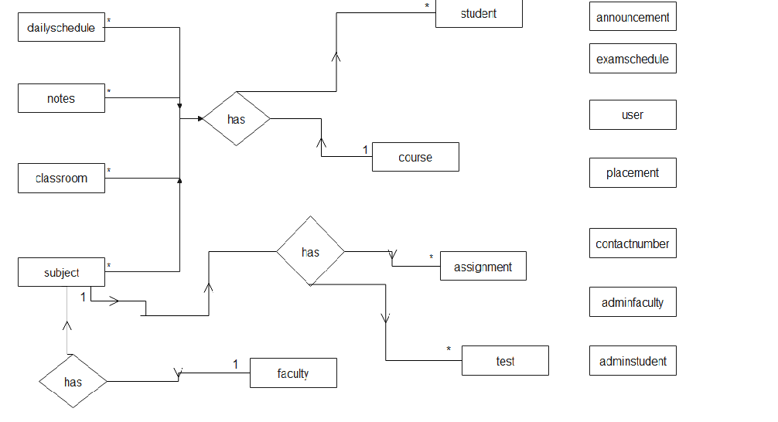
E-R Diagram

Slide 9
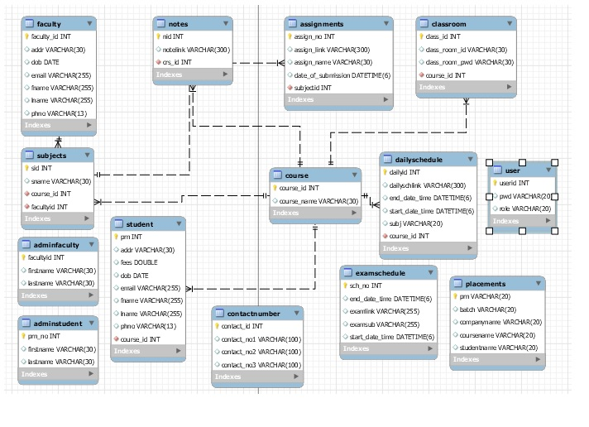
E-R Diagram(MySQL Auto generated)

Slide 10
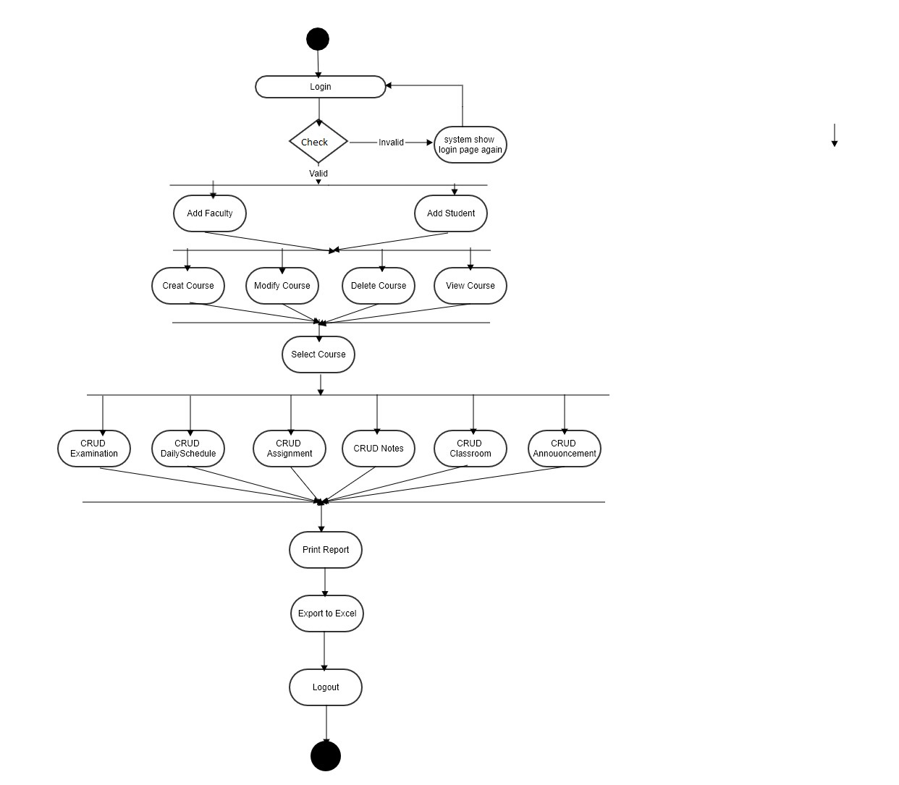
Activity Diagram Of Admin

Slide 11
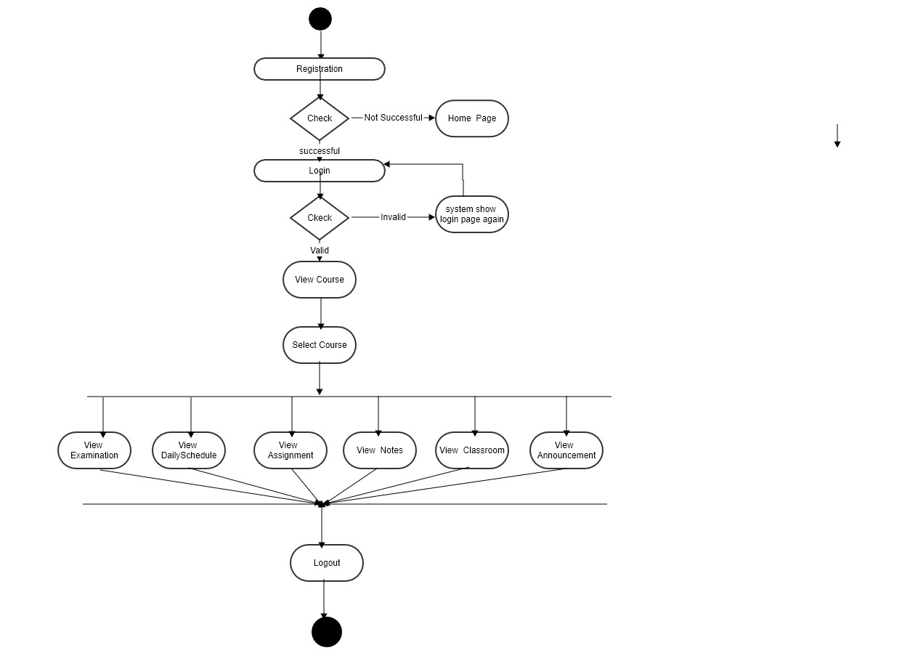
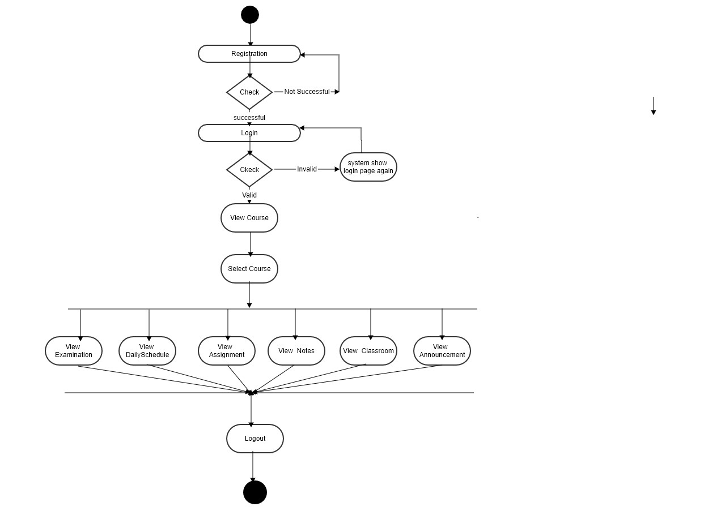
Faculty Activity Diagram
Student Activity Diagram

Slide 12
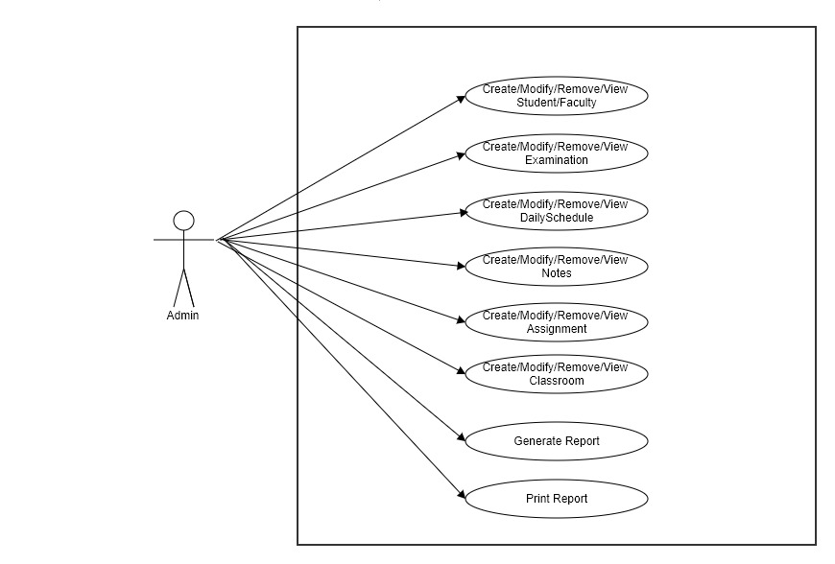
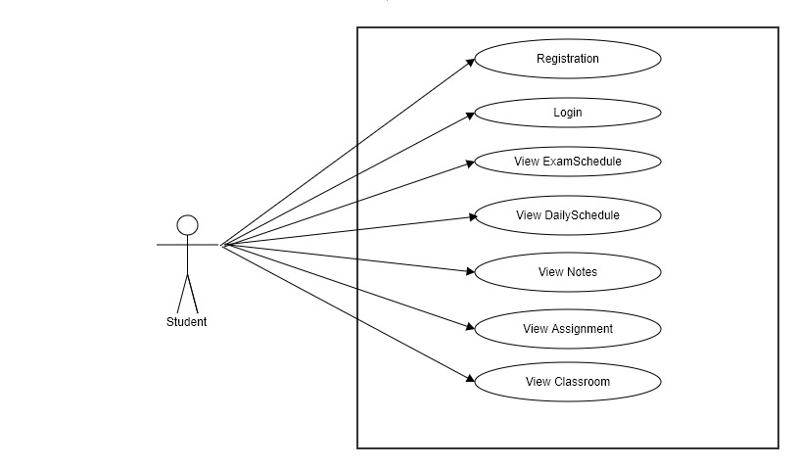
Admin UseCase
Diagram
Student/Faculty
UseCase Diagram

Slide 13
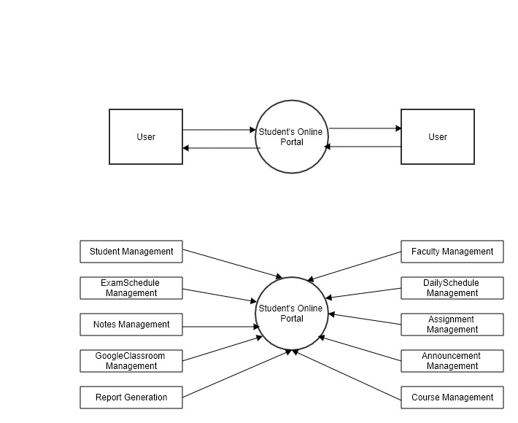
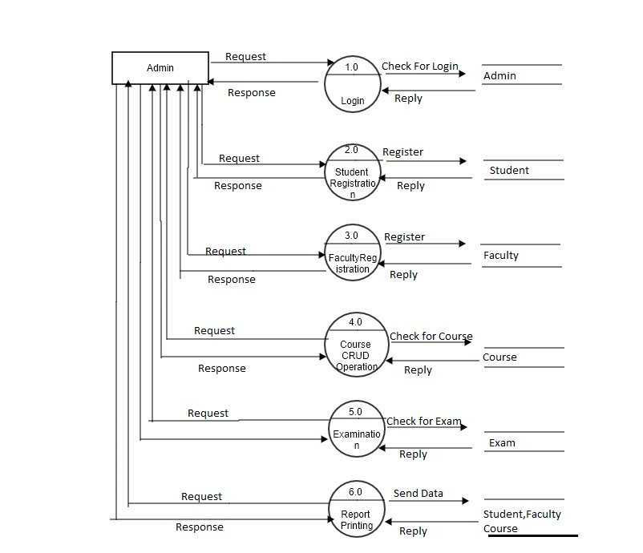
Level Two
DFD Diagram
Level Zero
Level One

Slide 14
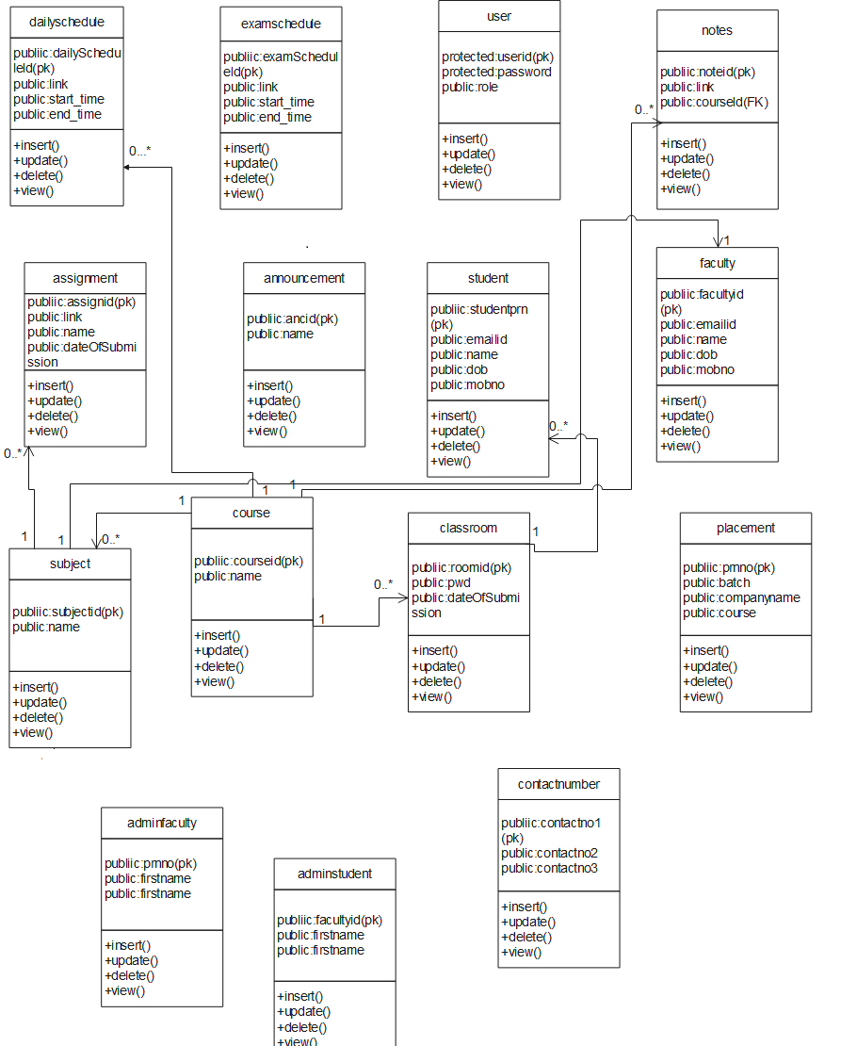
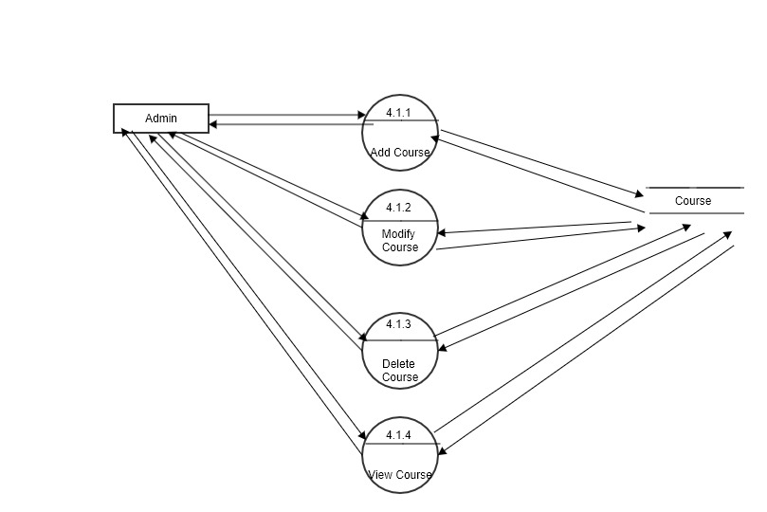
DFD Course Process
Class Diagram

Slide 15
Screen Shots

Slide 16
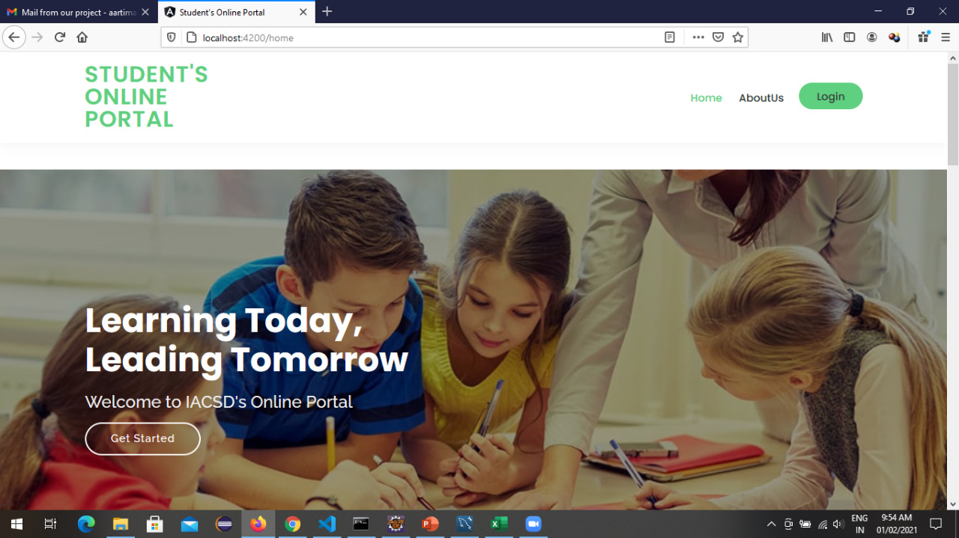

Slide 17
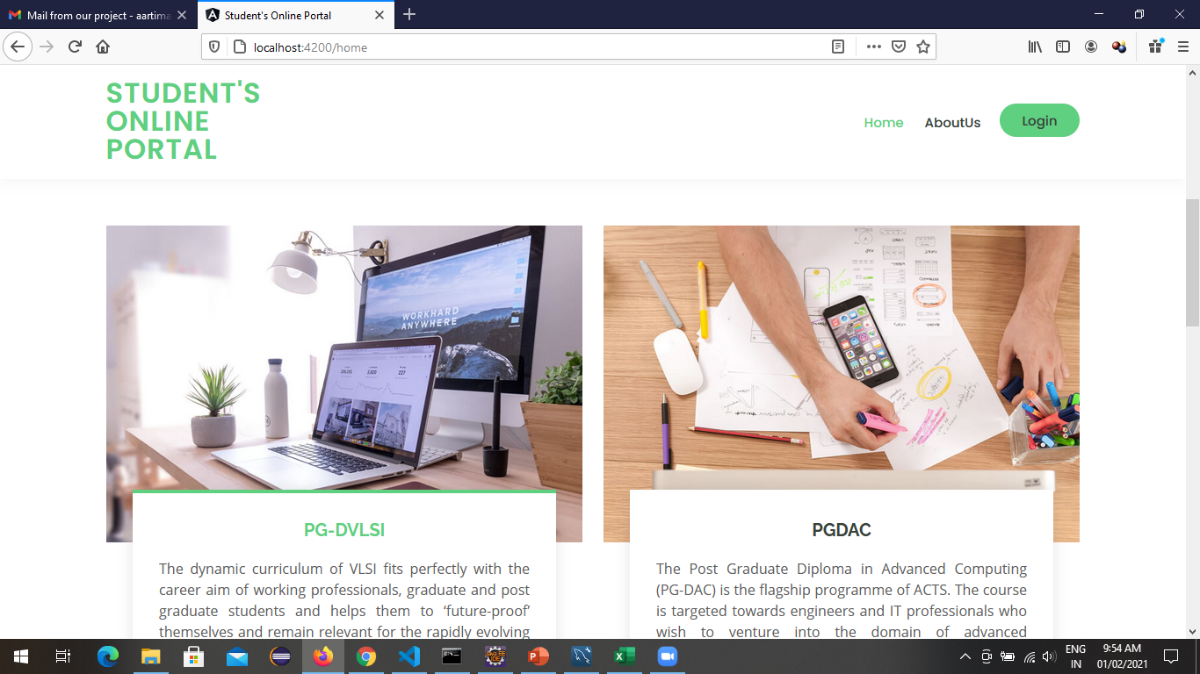
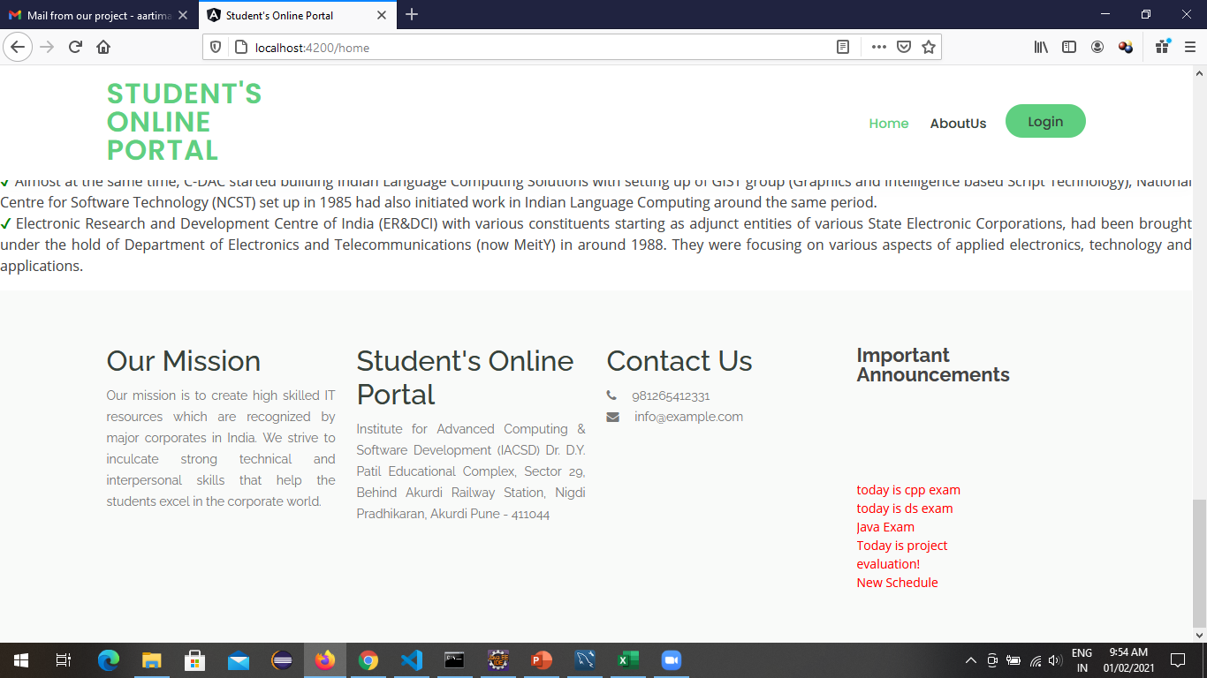
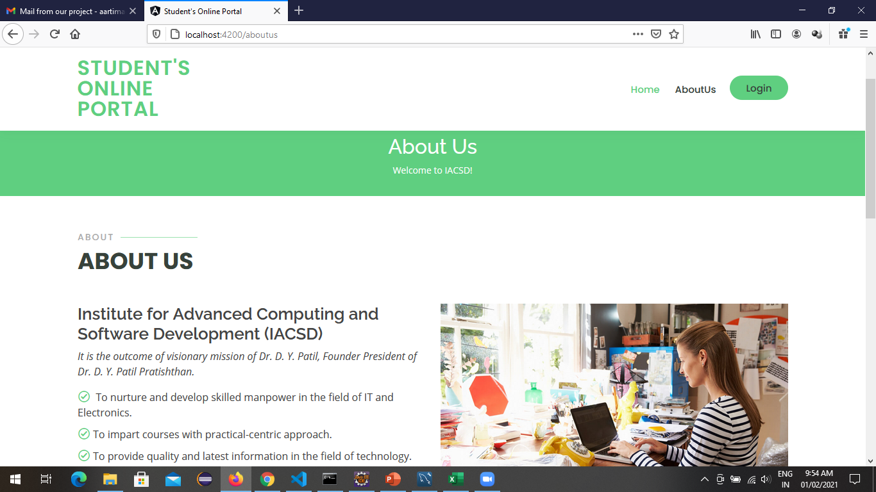

Slide 18
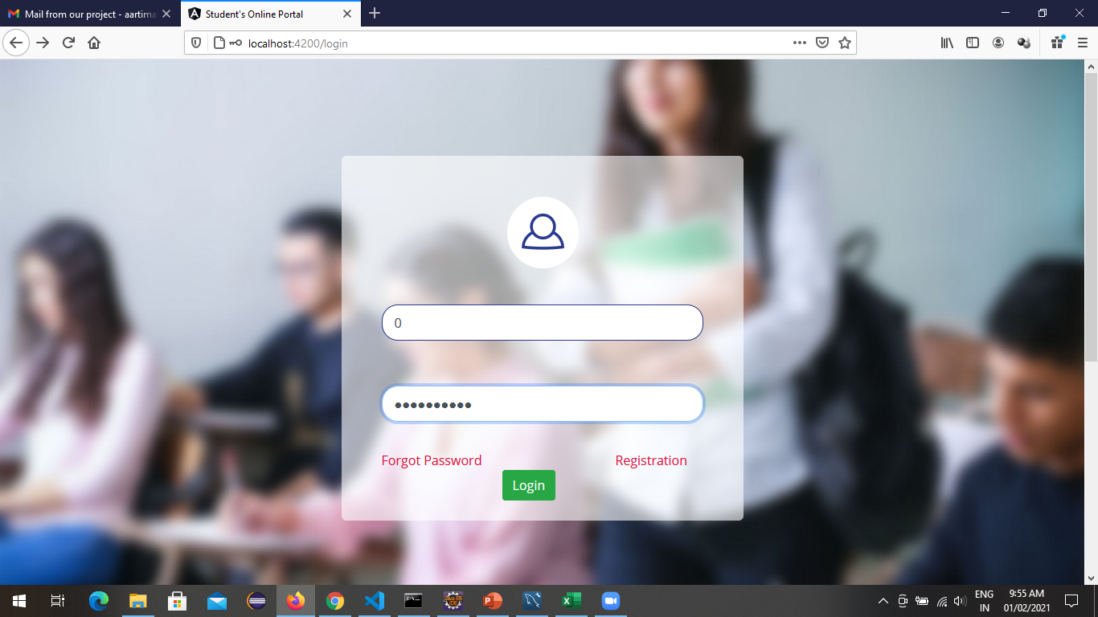
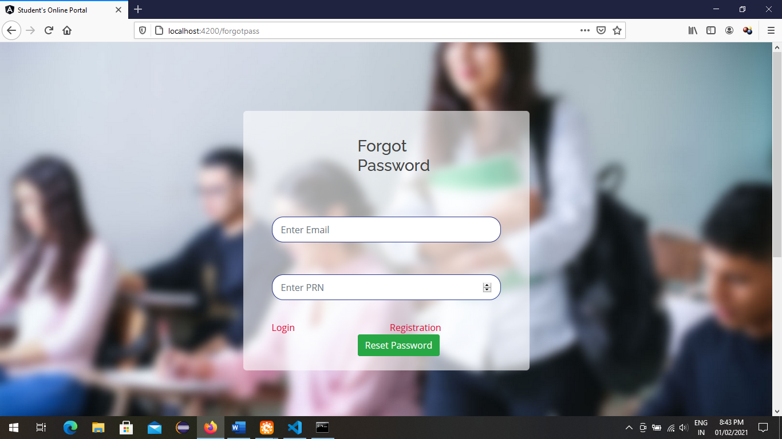
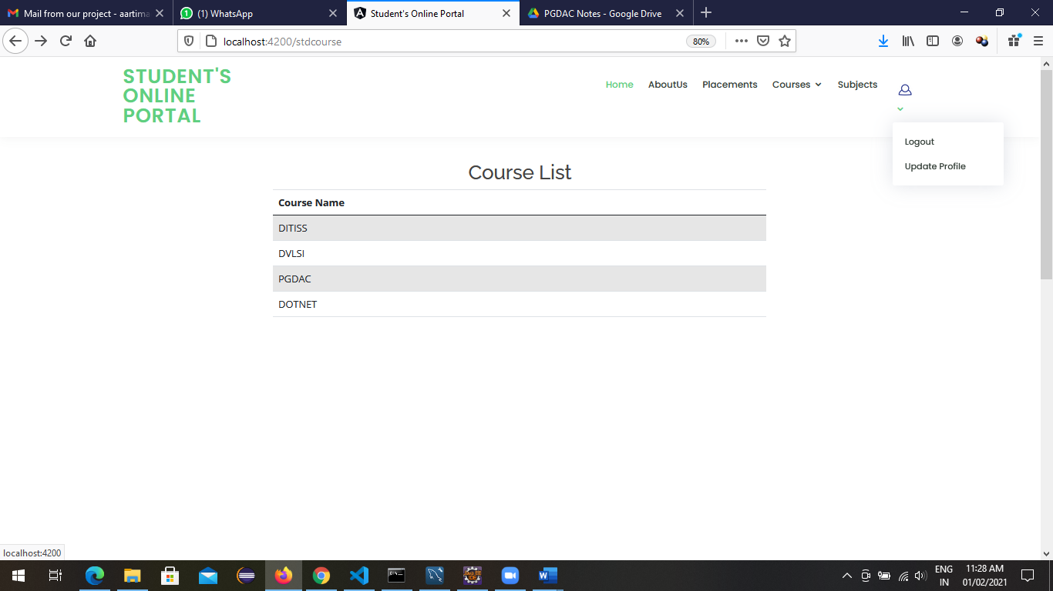
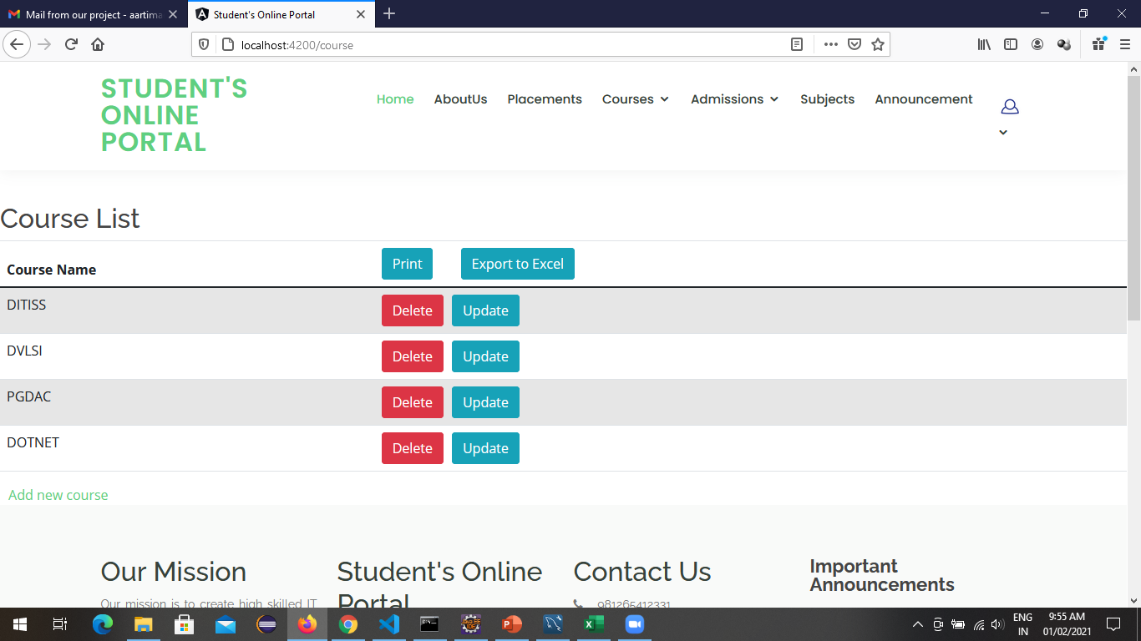

Slide 19
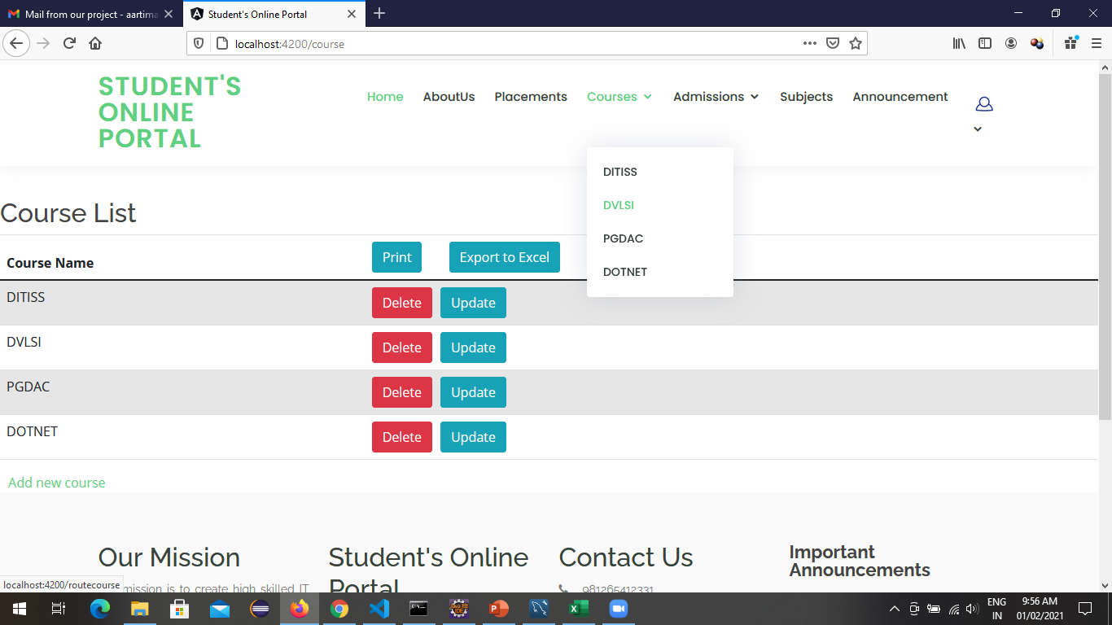
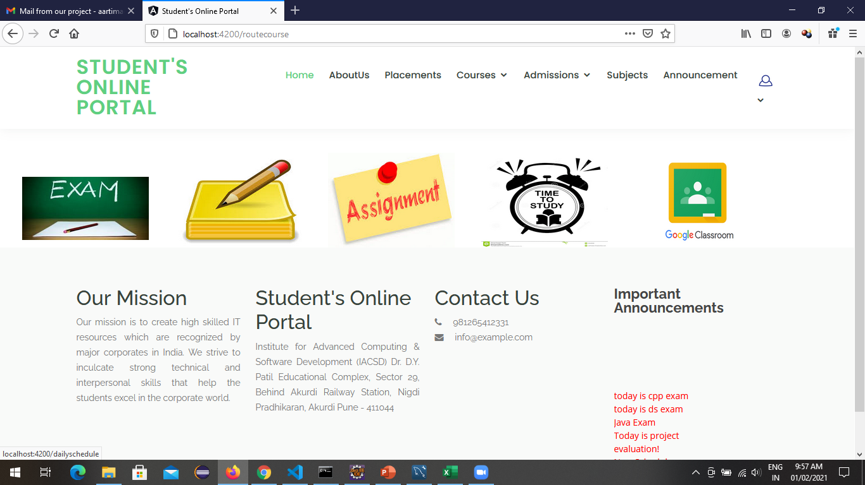
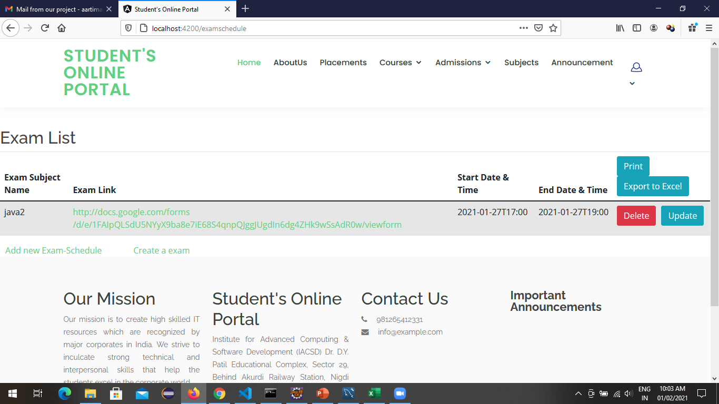
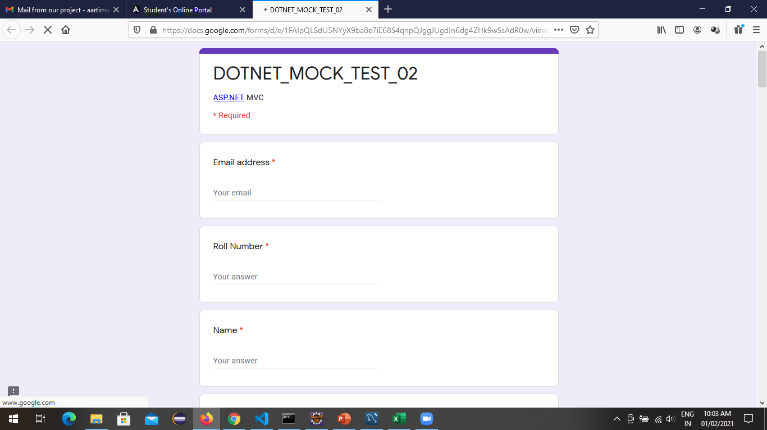

Slide 20
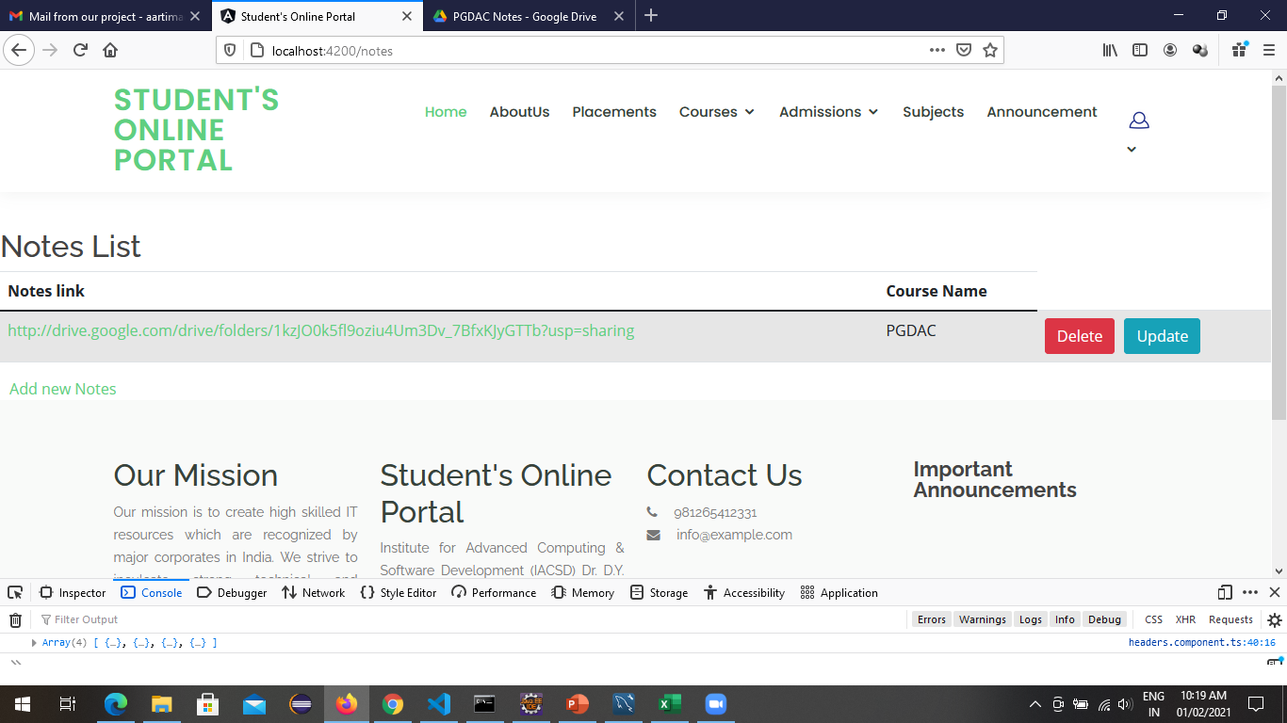
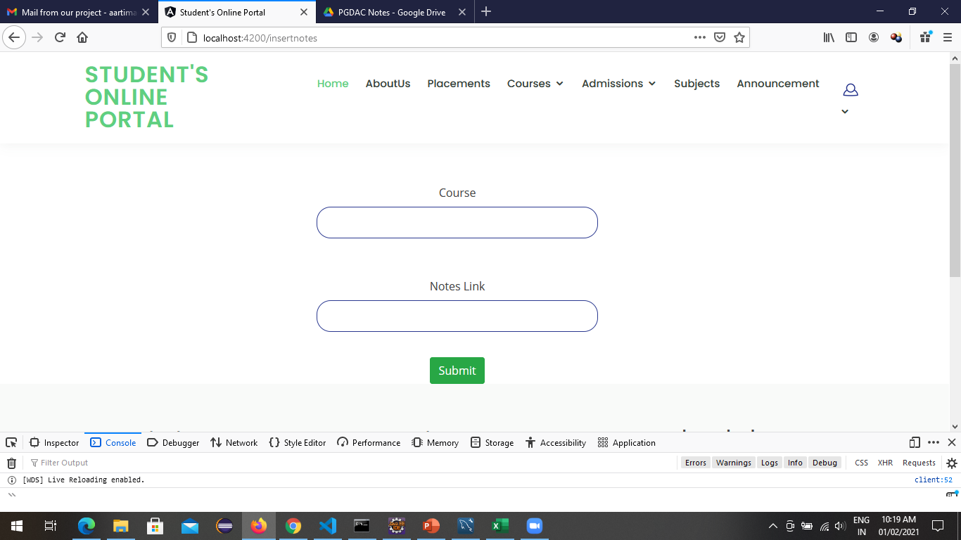
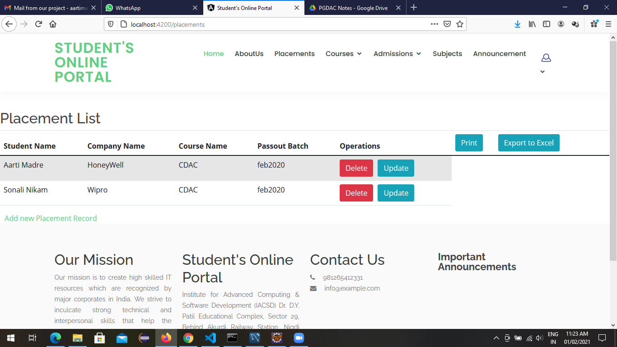
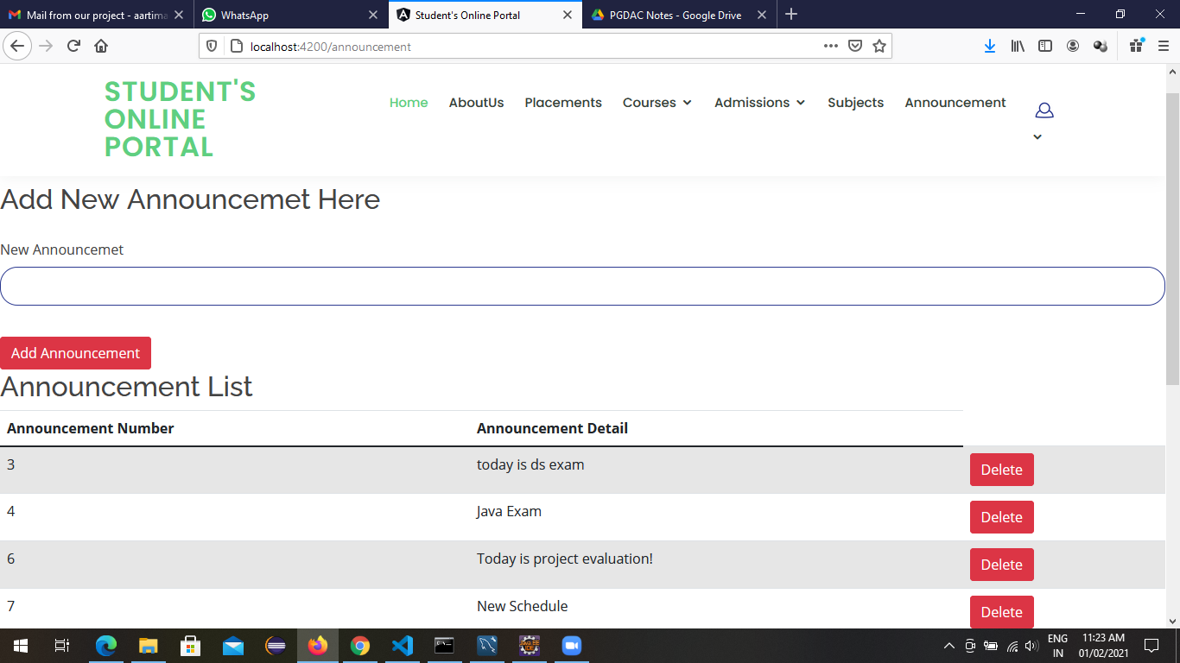

Slide 21
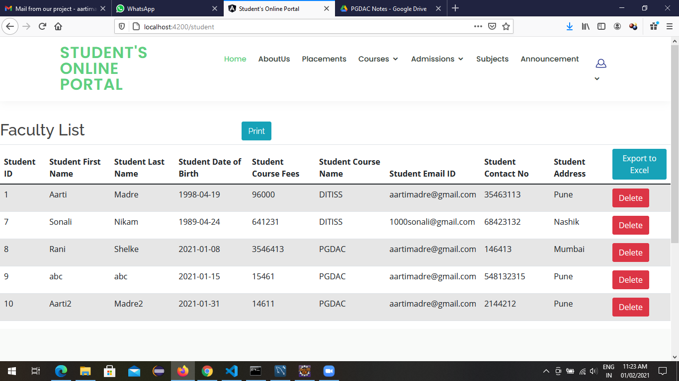
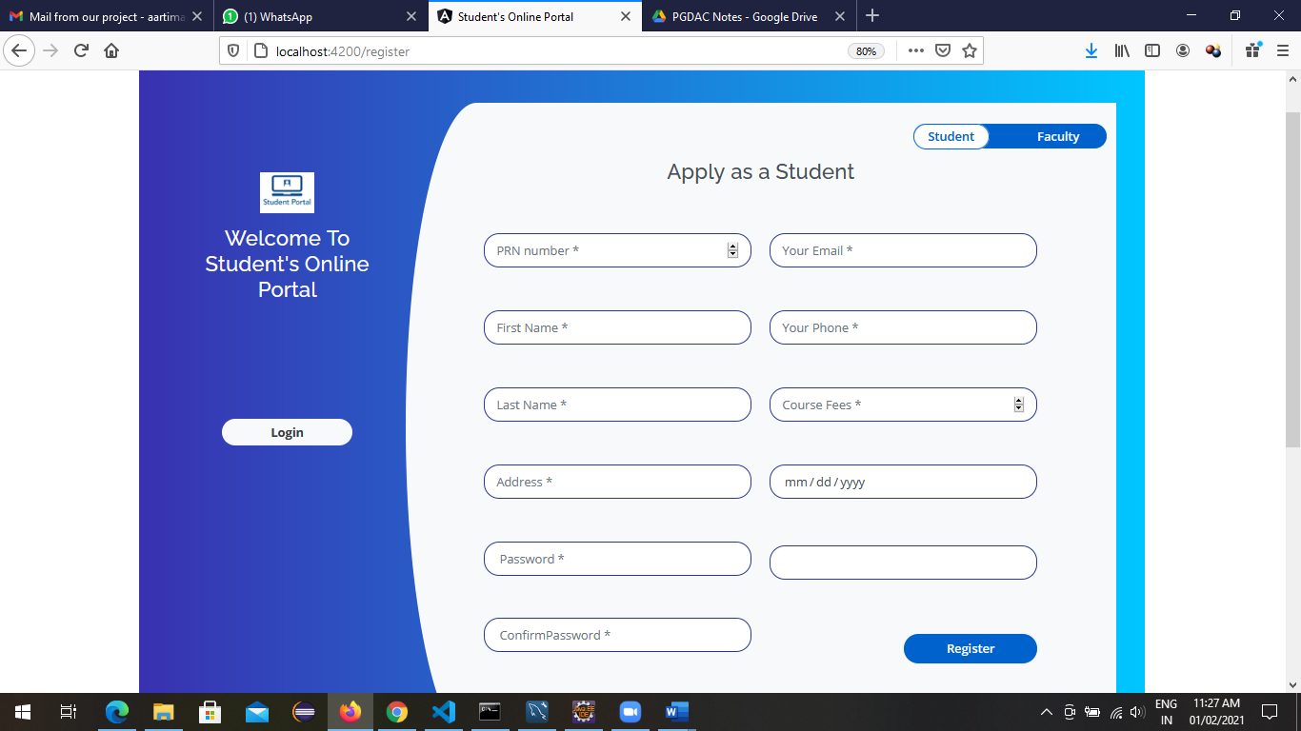
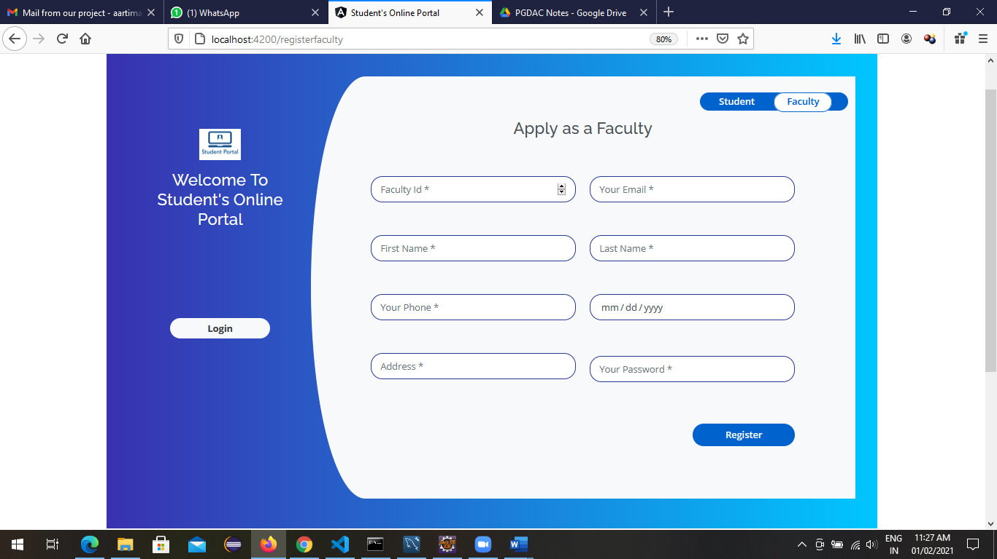

Slide 22
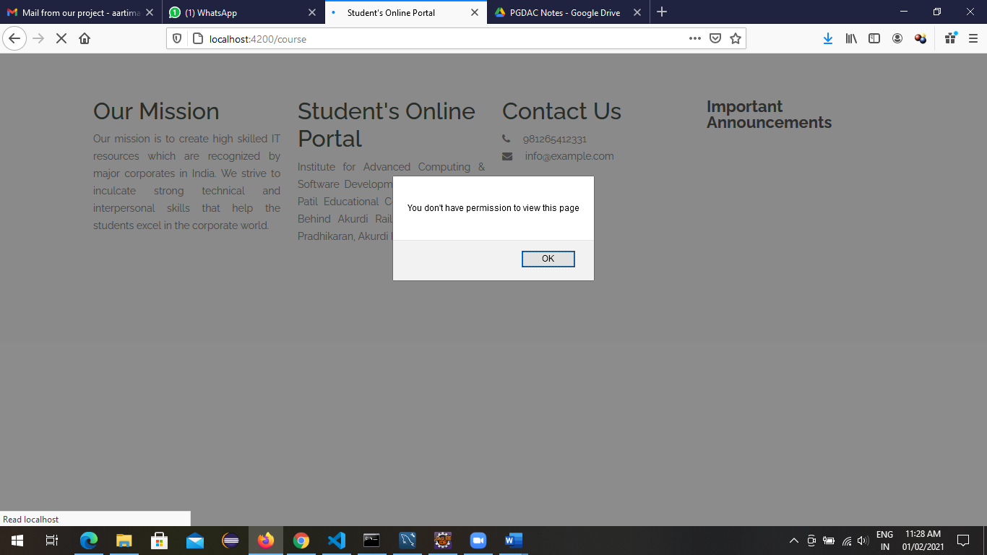
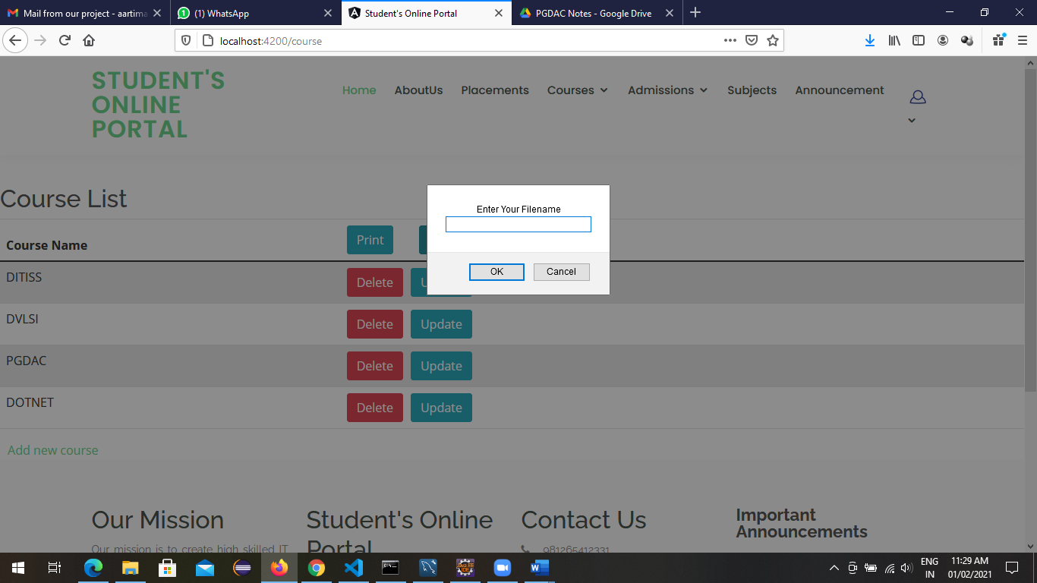
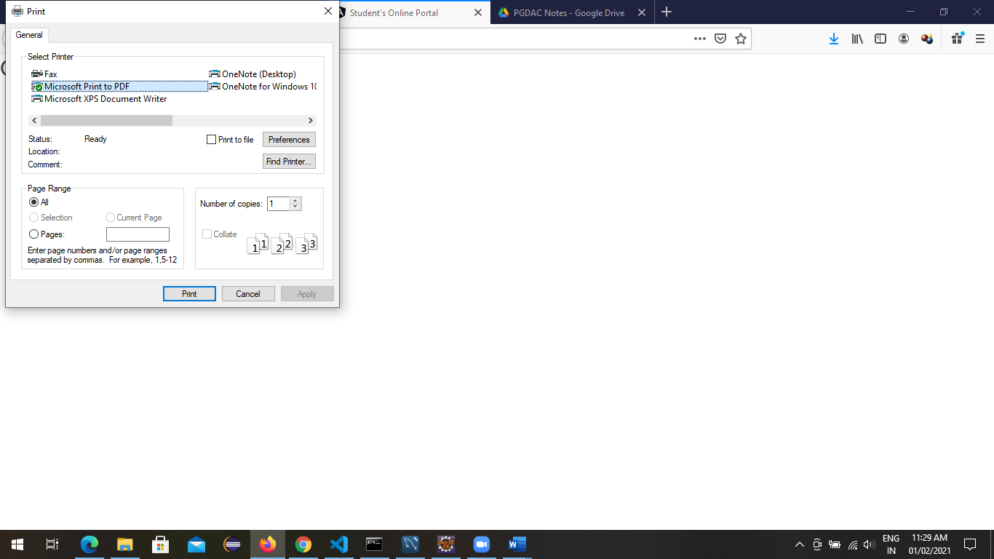
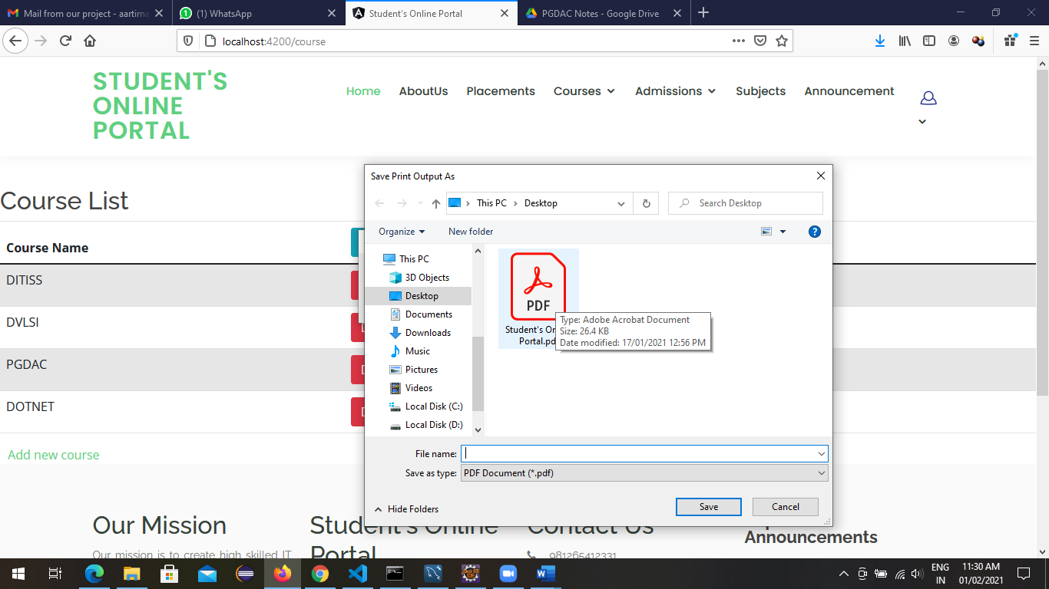

Slide 23
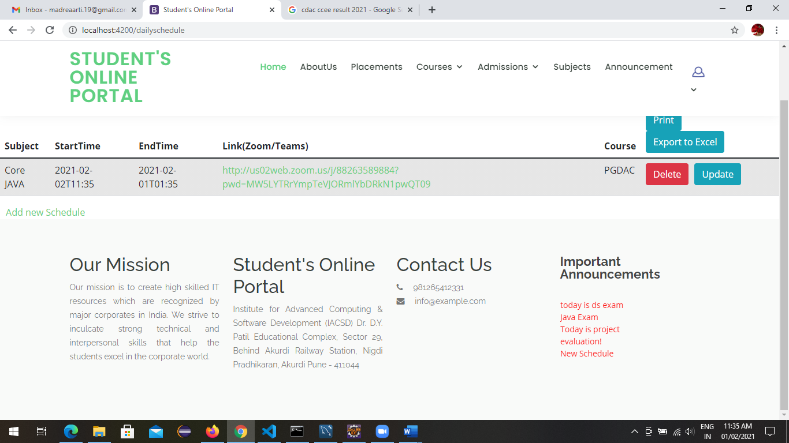
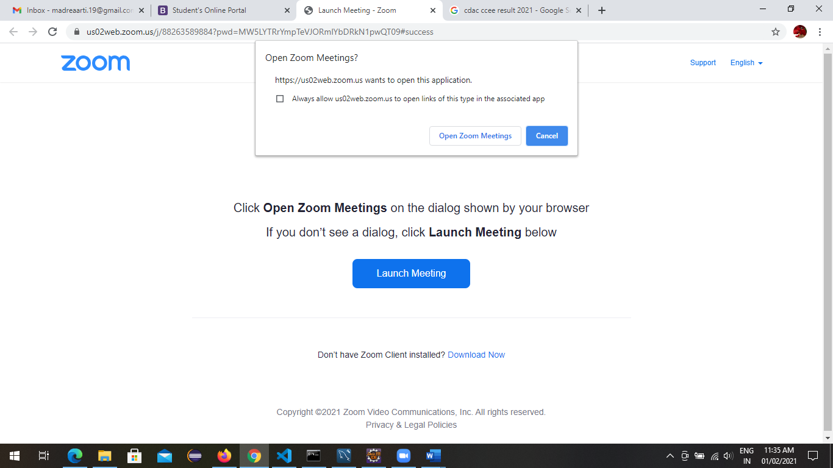
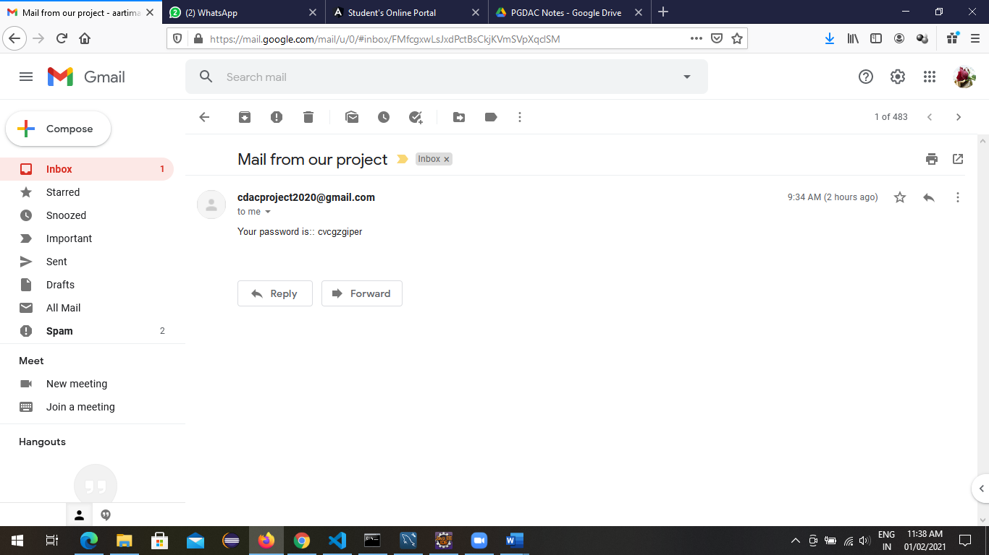
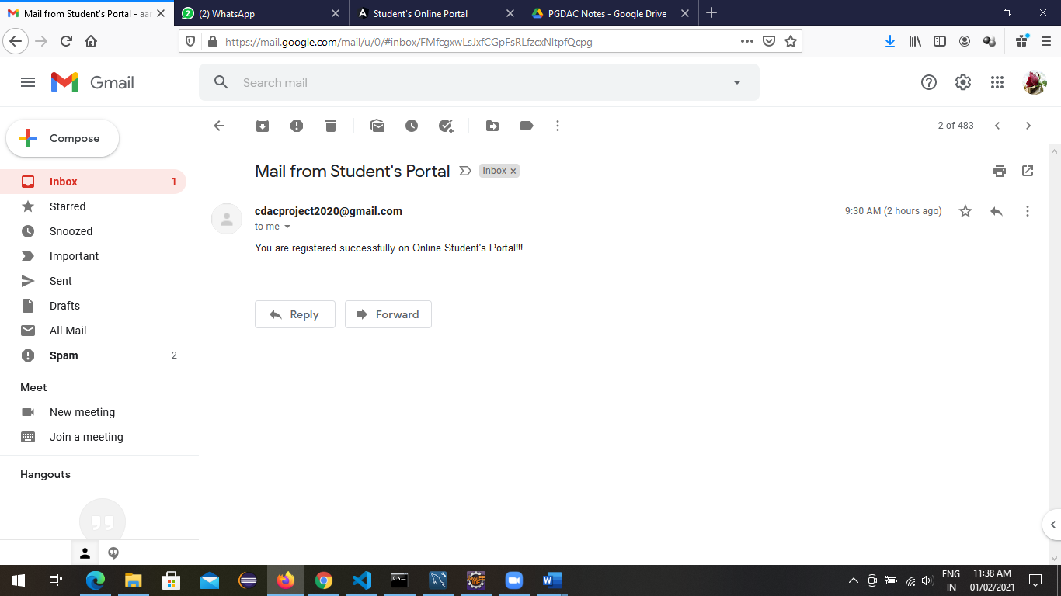

Slide 24
Specification
The application will use JavaScript, jQuery and CSS as main web technologies.
HTTP and FTP protocols are used as communication protocols. FTP is used to upload the web application in live domain and the client can access it via HTTP protocol.
SMTP protocol is used for Email communication.
Several types of validations make this web application a secured one and SQL Injections can also be prevented.
Since Student’s Online Portal is a web-based application, internet connection must be established.
The Student’s Online Portal will be used on PCs and will function via internet or intranet in any web browser.

Slide 25
S/W and H/W Requirements
Server Side:
Processor: Intel® Xeon® processor 3500 series
HDD: Minimum 500GB Disk Space
RAM: Minimum 4GB
OS: Windows 10, Linux 6
Database: MySQL
Client Side (minimum requirement):
Processor: Intel Dual Core
HDD: Minimum 80GB Disk Space
RAM: Minimum 2GB
OS: Windows 7, Linux

Slide 26
Advantages
Managing student information.
Effortless Communication.
Lesser time requirement to maintain and manage records of student and faculty.
Automatic record generation of day to day schedules, exams, courses and assignments.
Paper work is reduced due to record stored into excel sheets.
All requirements at one platform.

Slide 27
Disadvantages
Manual admission or document submission is required for registering to system.
No online payment facility given, hence payment must be done manually. But this can be done as future enhancement.

Slide 28
Conclusion
This project aid in automating the existing manual system. This is a paperless work. It can be monitored and guarded remotely. It cut down the man power required and provides accurate information. All years together huddled information can be saved and can be accessed at any time. For this reason, the data stored in the repository helps in taking decision by management. So, it is improved to have a Web Based system. All the stakeholders, faculty and authority can get the required information without delay. This system is crucial in the colleges and universities.

Slide 29
Future Enhancement
This project can be enhanced further by adding payable additional courses, online feedback system, online payment facility for the members to reduce the extra work of the admin.
The software is flexible enough to be modified and implemented as per future requirements.
We have tried our Best to present this free and user–friendly website to Institutes.

Slide 30
References
http://www.ijcstjournal.org/volume-7/issue-1/IJCST-V7I1P4.pdf
https://bootstrapmade.com/mentor-free-education-bootstrap-theme/
https://www.javatpoint.com/java-mail-api-tutorial
https://www.w3schools.com/
https://angular.io/docs
https://javaee.github.io/javaee-spec/javadocs/

Slide 31
THANK YOU

